Slide 1
Data Warehousing and Data Mining
Unit 4
Data Cube Technology

Slide 2
Data Cube Computation
Data cube computation is an essential task in data warehouse implementation. The pre computation of all or part of a data cube can greatly reduce the response time and enhance the performance of on-line analytical processing
Challenging because it may require substantial computational time and storage

Slide 3
Choices for Data Cube Materialization
No Materialization
Do not precompute any of the non base cuboids
Computation becomes extremely slow
Full Materialization
Precompute all of the cuboids
Requires huge amount of memory
Partial Materialization
Selectively compute the proper subset

Slide 4

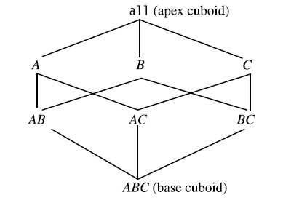
Data Cube Computation...

Slide 5
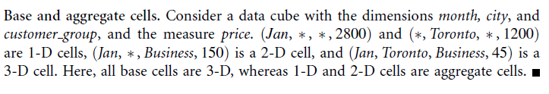
Data Cube Computation...

Slide 6
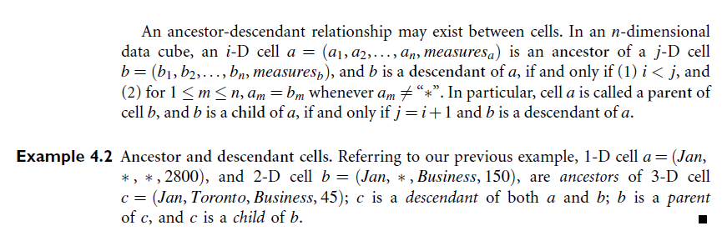
Data Cube Computation...

Slide 7
Cube Materialization
Full Cube
Iceberg Cube
Closed Cube
Shell Cube

Slide 8
Full Cube
Full cube is all the cells of all of the cuboids for a given data cube
The precomputation of the full cube can require huge amount of memory

Slide 9
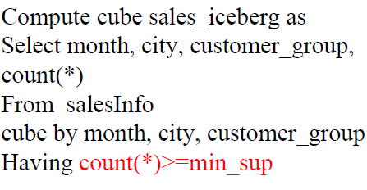
Iceberg Cube
Iceberg cube is the cells in a cuboids whose measure value is above some minimum threshold value

Slide 10
Closed Cube and Shell Cube
Closed Cube
A cell c, is closed cube if there exists no cell, d, such that d is specialization (descendent) of cell c
Closed cube is data cube consists of only closed cell
Shell Cube
Strategy for partial materialization, is to compute only the cuboids involving a smaller number of dimensions

Slide 11
General Strategies for Cube Computation
In general, there are two basic data structures used for storing cuboids. Relational tables are used as the basic data structure for the implementation of relational OLAP (ROLAP), while multidimensional arrays are used as the basic data structure in multidimensional OLAP (MOLAP)

Slide 12
General Strategies for Cube Computation
Optimization Technique 1: Sorting, hashing, and grouping
Sorting, hashing, and grouping operations should be applied to the dimension attributes in order to reorder and cluster related tuples
In cube computation, aggregation is performed on the tuples (or cells) that share the same set of dimension values. Thus it is important to explore sorting, hashing, and grouping operations to access and group such data together to facilitate computation of such aggregates

Slide 13
For example, to compute total sales by branch, day, and item, it is more efficient to sort tuples or cells by branch, and then by day, and then group them according to the item name
This technique can also be further extended to perform shared-sorts (i.e., sharing sorting costs across multiple cuboids when sort-based methods are used), or to perform shared-partitions (i.e., sharing the partitioning cost acrossmultiple cuboids when hashbased algorithms are used)

Slide 14
Optimization Technique 2: Simultaneous aggregation and caching intermediate results.
In cube computation, it is efficient to compute higher-level aggregates from previously computed lower-level aggregates, rather than from the base fact table. Moreover, simultaneous aggregation from cached intermediate computation results may lead to the reduction of expensive disk I/O operations
For example, to compute sales by branch, we can use the intermediate results derived from the computation of a lower-level cuboid, such as sales by branch and day

Slide 15
Optimization Technique 3: Aggregation from the smallest child, when there exist multiple child cuboids
When there exist multiple child cuboids, it is usually more efficient to compute the desired parent (i.e., more generalized) cuboid from the smallest, previously computed child cuboid
For example, to compute a sales cuboid,Cbranch, when there exist two previously computed cuboids, Cfbranch;yearg and Cfbranch;itemg, it is obviously more efficient to compute Cbranch from the former than from the latter if there are many more distinct items than distinct years

Slide 16
Optimization Technique 4: The Apriori pruning method can be explored to compute iceberg cubes efficiently
The Apriori property,3 in the context of data cubes, states as follows: If a given cell does not satisfy minimum support, then no descendant (i.e., more specialized or detailed version) of the cell will satisfy minimum support either

Slide 17
Data Generalization
Process that abstracts a large set of task-relevant data in a database from a relatively low conceptual level to higher conceptual levels
Data generalization summarizes data by replacing relatively low-level values (such as numeric values for an attribute age) with higher-level concepts (such as young, middleaged, and senior)

Slide 18
Data Generalization...
Approaches
Data cube approach(OLAP approach)
Attribute-oriented induction approach

Slide 19
Concept/Class Description
Data can be associated with classes or concepts
For example, in the AllElectronics store, classes of items for sale include computers and printers, and concepts of customers include bigSpenders and budgetSpenders
It can be useful to describe individual classes and concepts in summarized
Such descriptions of a class or a concept are called class/concept descriptions

Slide 20
Concept/Class Description…
These descriptions can be derived through
Data Characterization
Data Discrimination

Slide 21
Data Characterization
Is a summarization of the general characteristics or features of a target class of data
Includes process Statistical Measures (Mean, Median, Mode, Standard Deviation) , OLAP operation like Roll Up
Example (A data mining system should be able to produce a description summarizing the characteristics of customers who spend more than $1,000 a year at AllElectronics. The result could be a general profile of the customers, such as they are 40–50 years old, employed, and have excellent credit ratings)

Slide 22
Data Discrimination
Is a comparison of the general features of target class data objects with the general features of objects from one or a set of contrasting classes
For example, the user may like to compare the general features of software products whose sales increased by 10% in the last year with those whose sales decreased by at least 30% during the same period

Slide 23
Attribute-Oriented Induction (AOI) Approach
The data cube approach is essentially based on materialized views of the data, which typically have been precomputed in a data warehouse (i.e materialized view of data cube)
How it is done (General idea of AOI)?
Collect the task-relevant data
Perform generalization by attribute removal or attribute generalization
Apply aggregation by merging identical, generalized tuples and accumulating their respective counts
Interactive presentation with users

Slide 24
Attribute-Oriented Induction Approach(Example)
Suppose that a user would like to describe the general characteristics of graduate students in the Big University database, given the attributes name, gender, major, birth_place, birth_date, residence, phone#, and gpa
DMQL may like
use Big University DB
mine characteristics as “Science Students”
in relevance to name, gender, major, birth_place, birth_date, residence, phone#, gpa
from student
where status in “graduate”

Slide 25
Task Relevant Data
Data for analysis
Data are collected based on the information provided in the data mining query. Because a data mining query is usually relevant to only a portion of the database, selecting the relevant set of data not only makes mining more efficient, but also derives more meaningful results than mining the entire database
Specifying the set of relevant attributes (i.e., attributes for mining, as indicated in DMQL with the in relevance to clause)
For example, suppose that the dimension birth_place is defined by the attributes city, province or state, and country. Of these attributes, let’s say that the user has only thought to specify city. In order to allow generalization on the birth_place dimension, the other attributes defining this dimension should also be included

Slide 26
Task Relevant Data...
This where clause implies that a concept hierarchy exists for the attribute status. Such a concept hierarchy organizes primitive-level data values for status, such as “M.Sc.”, “M.A.”, “M.B.A.”, “Ph.D.”, “B.Sc.”, “B.A.”, into higher conceptual levels, such as “graduate” and “undergraduate.”

Slide 27
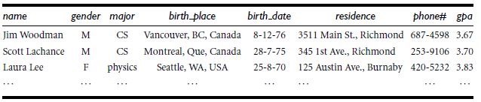
Task Relevant Data...
Now the query
use Big University DB
mine characteristics as “Science Students”
in relevance to name, gender, major, birth_place,
birth_date, residence, phone#, gpa
from student
where status in “graduate”
use Big University DB
select name, gender, major, birth _place,
birth_date, residence, phone#, gpa
from student
where status in {“M.Sc.”, “M.A.”, “M.B.A.”, “Ph.D.”}
Looks Like
Giving the Task Relevant Data as

Slide 28
Attribute Removal and Generalization
name: Since there are a large number of distinct values for name and there is no generalization operation defined on it, this attribute is removed
gender: Since there are only two distinct values for gender, this attribute is retained and no generalization is performed on it
major: Suppose that a concept hierarchy has been defined that allows the attribute major to be generalized to the values {arts&science, engineering, business}
Birth_place: This attribute has a large number of distinct values; therefore, we would like to generalize it. Suppose that a concept hierarchy exists for birth place, defined as “city < province or state < country”
Birth_date: Suppose that a hierarchy exists that can generalize birth date to age, and age to age range, and that the number of age ranges
residence : Suppose that residence is defined by the attributes number, street, residence city, residence province or state, and residence country
phone#: As with the attribute name above, this attribute contains too many distinct values and should therefore be removed in generalization
gpa: Suppose that a concept hierarchy exists for gpa that groups values for grade point average into numerical intervals like f3.75–4.0, 3.5–3.75,. . .g, which in turn are grouped into descriptive values, such as fexcellent, very good,. . .g. The attribute can therefore be generalized

Slide 29
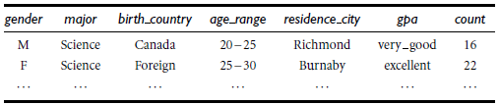
Attribute Removal and Generalization…
Are Removed
Generalized relation obtained by AOI
Based on the vocabulary used in OLAP, we may view count as a measure, and the
remaining attributes as dimensions

Slide 30
Presentation of Generalized Results
Generalized relation:
Relations where some or all attributes are generalized, with counts or other aggregation values accumulated.
Cross tabulation:
Pie charts, bar charts, curves, cubes, and other visual forms.
Quantitative characteristic rules:
Mapping generalized result into characteristic rules with quantitative information associated with it, e.g.,

Slide 31
Mining Class Comparisons
Users may not be interested in having a single class (or concept) described or characterized, but rather would prefer to mine a description that compares or distinguishes one class (or concept) from other comparable classes (or concepts)
Mines descriptions that distinguish a target class from its contrasting classes
Notice that the target and contrasting classes must be comparable in the sense that they share similar dimensions and attributes
For example, the three classes, person, address, and item, are not comparable
However, the sales in the last three years are comparable classes, and so are computer science students versus physics students

Slide 32
How is class comparison performed?
Data Collection
set of relevant data in the database is collected by query processing and is partitioned respectively into a target class and one or a set of contrasting class(es)
Dimension Relevance Analysis
select only the highly relevant dimensions for further analysis
Synchronous Generalization
Generalization is performed on the target class to the level controlled by a user- or expert-specified dimension threshold
Presentation of the Derived Comparison
Results can be visualized in the form of tables, graphs

Slide 33
Mining Class Comparisons...
Comparison: Comparing two or more classes
Method:
Partition the set of relevant data into the target class and the contrasting class(es)
Generalize both classes to the same high level concepts
Compare tuples with the same high level descriptions
Present for every tuple its description and two measures
support - distribution within single class
comparison - distribution between classes
Highlight the tuples with strong discriminant features

Slide 34
Mining Class Comparisons (Example)
Suppose that we would like to compare the general properties between the graduate students and the undergraduate students at Big University, given the attributes name, gender, major, birth_place, birth_date, residence, phone#, and gpa

Slide 35
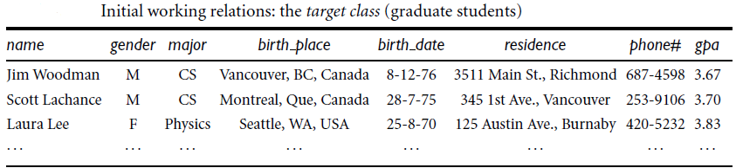
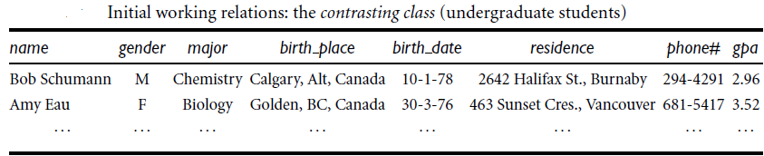
Mining Class Comparisons (Example)…
First Phase :- Task Relevant Data

Slide 36
Mining Class Comparisons (Example)…
Second Phase (Dimension Relevance Analysis)
Only the highly relevant attributes are included in the subsequent analysis
Irrelevant or weakly relevant dimensions, such as name, gender, birth_place, residence, and phone#, are removed from the resulting classes

Slide 37
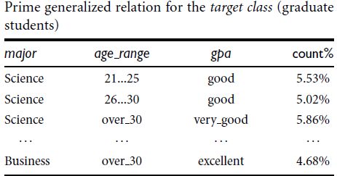
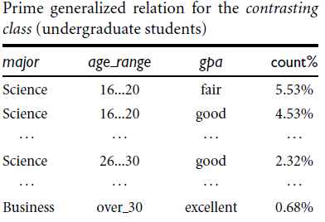
Mining Class Comparisons (Example)…
Third Phase : (Synchronous Generalization)

Slide 38
Mining Class Comparisons (Example)…
Fourth Phase : (Result Presentation)
Resulting class comparison is presented in the form of tables, graphs, or contrasting measure (such as count%) that compares between the target class and the contrasting class
For example, 5.02% of the graduate students majoring in Science are between 26 and 30 years of age and have a “good” GPA, while only 2.32% of undergraduates have these same characteristics

Slide 39
Discriminating between different classes
The discriminative features of the target and contrasting classes of a comparison description can be described quantitatively by a quantitative discriminant rule
Associates a statistical interestingness measure, d-weight, with each generalized tuple in the description
The d-weight for q_{a} is the ratio of the number of tuples from the initial target class working relation that are covered by q_{a} to the total number of tuples in both the initial target class and contrasting class working relations that are covered by q_{a}

Slide 40
Quantitative Discriminant Rules...
C_{j} = target class
q_{a} = a generalized tuple covers some tuples of class
but can also cover some tuples of contrasting class
d-weight
range: [0, 1]
where m is the total number of the target and contrasting classes, C_{j} is in {C₁, ..... , C_{m}}
and count (q_{a} ∈ C_{i}) is the number of tuples of class C_{i} that are covered by q_{a}
A high d-weight in the target class indicates that the concept represented by the generalized tuple is primarily derived from the target class, whereas a low d-weight implies that the concept is primarily derived from the contrasting classes

Slide 41
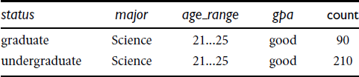
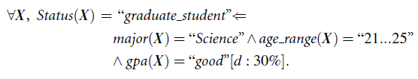
Example: Quantitative Discriminant Rule
Let the count distribution for the generalized tuple, major = “Science” AND age range = “21. . . 25” AND gpa = “good”
The d-weight for the given generalized tuple is 90/(90 + 210) = 30% with respect to the target class, and 210/(90 + 210) = 70% with respect to the contrasting class
That is, if a student majoring in Science is 21 to 25 years old and has a “good” gpa, then based on the data, there is a 30% probability that she is a graduate student, versus a 70% probability that she is an undergraduate student

Slide 42
End of Session

